Slide 1
  Medical Events
Level - Practioner

Slide 2
About the Author
Created By: | Saranya Sampath, Sourav Bhattacharjee
Credential Information: | Programmer Analyst; Associate - Projects
Version and Date: | v1 26/01/2018 V2.0: July-2023:Updated with Lightning UI
Modified By: | Ritesh Kumar Prasad & Srijena,N

Slide 3
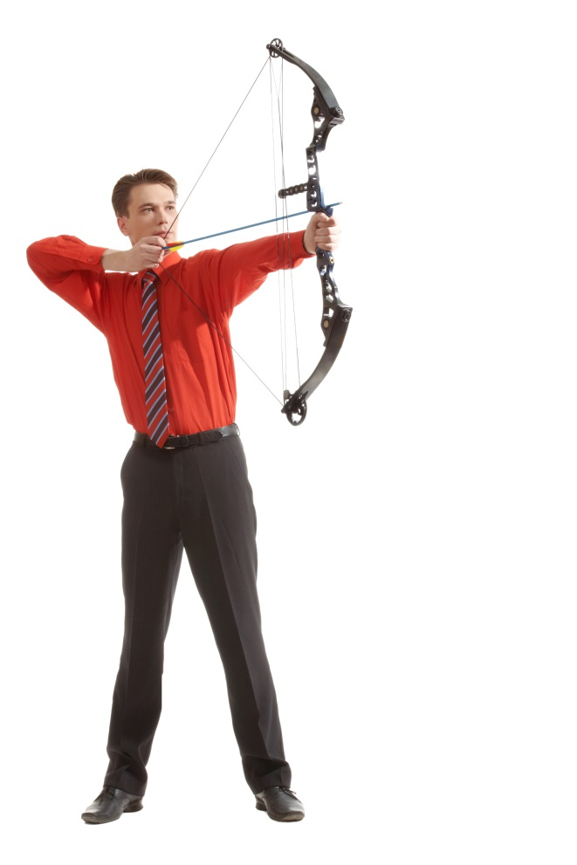
Objectives
After completing this chapter, you will learn to:
Describe a Medical Event and its features
Identify Event Attendees
- Event Attendee Record Types
Configure Custom Buttons
- Add Attendee button
- Add My Attendance button
Manage Attendees
Capture and View Attendee signatures
Edit and grant permissions in Sign-In Sheet
Record Calls with Medical Events

Slide 4
Recap ...
In the previous Module – Medical Inquiries, you learnt to ...
  Define Medical Inquiries Life Cycle
  Describe the components of Medical Inquiry
  Configure various components of Medical Inquiry module
  Configure Medical Inquiry module for multiple Product inquiries
And now ...

Slide 5

Do You Know
Medical events are conducted regularly by Medical Teams to engage with the stakeholders, across channels
An event can have hundreds of participants and it can be cumbersome to manually register attendees and track expenses
VEEVA has a solution for this in form of Medical Event management which is to plan and execute all events across the organization. It gives you seamless control and total visibility of all speakers, attendees, activities, and spend, for better events with greater compliance

Slide 6
VEEVA Medical Event Object

Slide 7
Medical Events - Features …..1
Medical event is VEEVA custom functionality to store medical event details such as name, start date, end date, event description and incurred expenses
It allows users to search across Person Accounts, Business Accounts and Users via a single search mechanism to add them as attendee
Sales representatives have the ability to capture signatures of multiple attendees of Medical Events in a single screen
The iPad platform also supports a Self Service Sign In sheet, which allows the rep’s iPad to be safely handed to attendees of the Medical Event so that they can sign in themselves

Slide 8
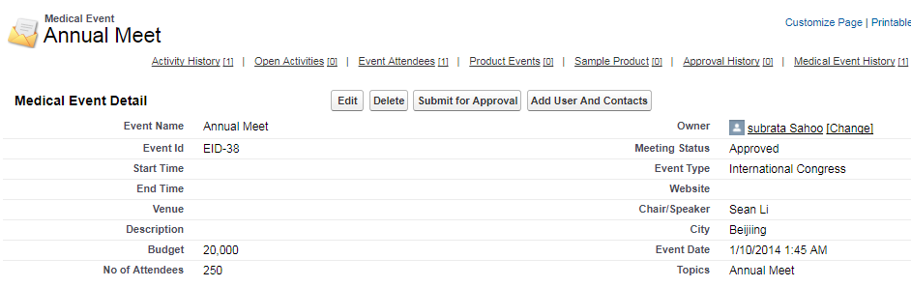
Medical Events - Features….2
Sales reps can record Medical Events in VEEVA, which displays the event name, start date, end date, event description and incurred expenses. Users have the ability to manage attendees, and record calls from a medical event page

Slide 9
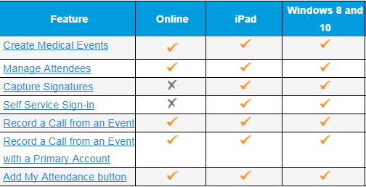
Supported Platforms
Some features of Medical Events have platform dependency. Please refer to below table-

Slide 10
Medical Events- Display
Medical Events can be displayed with Start and End dates in below calendar views
  Agenda view
  Week View
  Month view (Online)
  Timeline
  Multichannel Calendar
  Note: Medical Events are displayed in Purple color in Multichannel Calendar

Slide 11

Display- Configuration
VEEVA admin needs to provide user FLS (Field Level Security) to below fields and add them to Medical event page layout
  Start_time_vod
  End_time_vod
If the below fields are already added in page layout, remove them
  Start_date_vod
  End_date_vod

Slide 12
Event Attendees

Slide 13
Event Attendees
Event Attendees are stored in the Event_Attendee_vod object, which keeps track of the attendance of Accounts and Contacts to Medical Events
  To enable Business Accounts linking to Medical events, set the VEEVA settings Business Account Attendee Mode to 1
  If an individual attendee is signing on behalf of a business account, grant edit permission to the Signee_vod field on the Event Attendee object

Slide 14
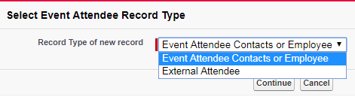
Event Attendee Record Types
The below Record Types are currently being utilized in Event Attendee object
  Event Attendee Contacts or Employee record type is used to add attendees within Organization
  External Attendee record type is used to add external attendees outside the organization

Slide 15
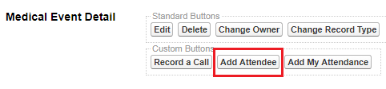
Add Attendee Button- Configuration
The Add Attendee (Add_Attendee_vod) button is a custom button that allows users to search across Person Accounts, Business Accounts and Users via a single search mechanism
To enable this button, drag and drop the Add Attendee button to the Medical Event page layout
Note: The Add Attendee button will not allow for duplicate records to be added to the Event Attendees section of a Medical Event

Slide 16
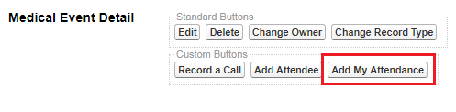
Add My Attendance Button- Configuration
The Add My Attendance (Add_My_Attendance_vod) is a custom button that can add the logged in user as an Event Attendee to the current Medical Event
To enable this button, drag and drop the button to Medical Event page layout-

Slide 17
Manage Attendees for Medical Events

Slide 18
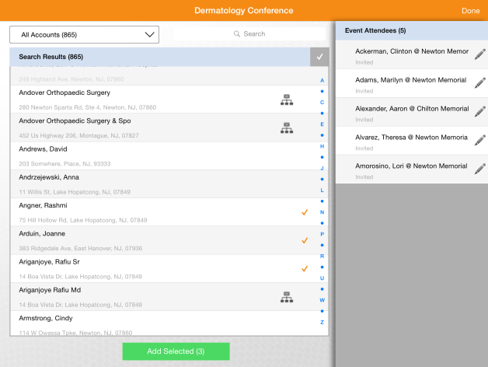
Manage Attendees
Users can add multiple attendees (person accounts, users, and contacts) at the same time to a medical event using queries and filters in the Manage Attendees section
The filters will only load the first 5000 accounts when adding attendees
To prevent accidentally adding too many attendees, the Toggle All check box is limited to 50 accounts. Business accounts will display for hierarchies

Slide 19
Manage Attendees - Configuration
In order to use the manage attendee feature, VEEVA admin need to make the following changes:
  Grant profile permission for the Visualforce page named Manage_Attendees_vod. The Manage Attendees button will not work properly if this isn’t added
  Add Manage Attendees (Manage_Attendees_vod) button to the custom buttons section of the Medical Event page layout: allows the Plus (+) icon to display in CRM for iPad
  User must have read, write permission for the Mobile_ID_vod field
  User must have Create permission on the Event Attendee object. It is recommended to have Edit and Delete permission
  Note: User must have DELETE permission on Event attendee object. If an account has a sign, user cannot remove an attendee from the attendees list.

Slide 20
Capturing and Viewing Attendee Signatures

Slide 21
Event Attendee Signature Capture
Sales representatives have the ability to capture signatures of attendees of Medical Events. To enable this feature, below changes are required:
  Add the Signature_Datetime_vod field to the Event Attendee related list on the Medical Event page layout
  The Event Attendee Status_vod picklist should contain these values: Signed_vod and Cleared_Signature_vod
  The Exclude_Field_List_vod field on the VMobile Object Configuration record for Event_Attendee_vod should contain the value Signature_vod__c
  An optional disclaimer can also be displayed by populating the DISCLAIMER_MEDICAL_EVENT VEEVA message

Slide 22
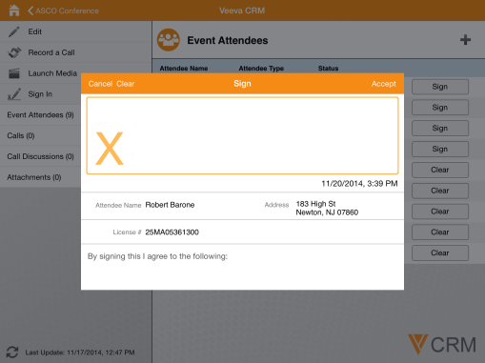
Signature Page
This functionality is supported on tablet and iPad platforms, as well as Windows 10. The page will show the disclaimer as well attendee details

Slide 23
Viewing Medical Event Signatures
Customers need the ability to audit signatures for Medical Event attendees because expenses are often tied to physicians attending events. To enable this-
  Add the View Signatures button on the Medical Events detail page
  Provide users Read access to Medical_Event_vod and Event Attendee_vod objects to View_Event_Signatures_vod Visualforce page
  Users also need FLS to the following fields on the Event_Attendee_vod object: Attendee Name, Status, Signature Datetime and Signature

Slide 24
Attendee Sign-In Sheet

Slide 25
Sign-In sheet 1
The iPad platform also supports a Self Service Sign In sheet, which allows the rep’s iPad to be safely handed to attendees of the Medical Event so that they can sign in themselves
While the Sign-In sheet is displayed, the application is locked – clicking the lock icon on the top right will require the rep to enter his password to return to the application
When the Signature_Datetime_vod field is present on the Event Attendees related list, a Sign In operation button appears in the Medical Event Detail page. Tap this button to access the Self Service Sign In sheet
If an individual attendee is signing on behalf of a business account, grant edit permission to the Signee_vod field on the Event Attendee object. This displays a Signee text field to be entered when a signature is captured

Slide 26
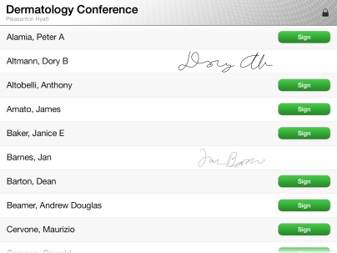
Sign-In sheet 2
The Sign_In sheet looks like the following in an iPad

Slide 27
Record Calls with Medical Events

Slide 28
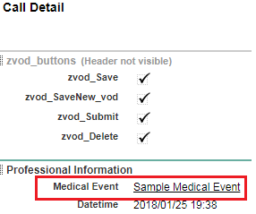
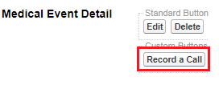
Record Call from Medical Events
Medical Events can be tied to calls using any of the below 2 ways-
  Place the Medical_Event_vod field on the call page layout
  Place the Medical_Event_vod field to the Call2_Discussion_vod page layout
Place the Record_a_Call_vod custom button in the Medical_Event_vod page layout
The user must be provided access to the Event_vod call record type

Slide 29

Check Your Understanding 1
How to change the label of out-of-the-box record types for medical event object?
Change the label from setup
Use the Translation Workbench to provide custom values for medical event record types tab
Answer: Use the Translation Workbench to provide custom values for medical event record types tab

Slide 30
Check Your Understanding 2
Which of the below options is appropriate to display a disclaimer message in Medical Event signature page?
By populating DISCLAIMER_MEDICAL_EVENT VEEVA Message
Setting a default value for DISCLAIMER_MEDICAL_EVENT field in Medical Event object
Answer: By populating DISCLAIMER_MEDICAL_EVENT VEEVA Message
30

Slide 31
Check Your Understanding 3
Can more than one Attendee Sign in the Self- Service Sign In sheet ?
Yes
No
Answer: Yes
31

Slide 32
Check Your Understanding 4
What is the Security measure taken to avoid accessing/misusing the Application while the Attendees hand over the iPad to other Attendees for Signing in the Sign-In sheet ?
There is no way to secure the Application and any user can access it
The Application will be locked and it requires the username and password to access the Application
Needs a finger print of the user to access the Application
Answer: The Application will be locked and it requires the username and password to access the Application
32

Slide 33

Summary
In this module, you have learnt to:
Use features of Medical Event’s object in VEEVA
Configure Event Attendees with different Event Attendee Record Types
Configure Custom Buttons – Attendee and My Attendance buttons
Manage Attendees
Capture and View Attendee signatures
Access and grant edit permissions in Sign-In Sheet for Attendees on iPad
Record Calls with Medical Events

Slide 34

Source
https://crmhelp.veeva.com/doc/Content/Home.htm
Disclaimer: Parts of the content of this course is based on the materials available from the Web sites and books listed above. The materials that can be accessed from linked sites are not maintained by Cognizant Academy and we are not responsible for the contents thereof. All trademarks, service marks, and trade names in this course are the marks of the respective owner(s).

Slide 35
  You have successfully completed
  Medical Events

Slide 36
Exit Assessment

Slide 37
Exit Assessment
Please take up the below Exit Assessment in order to complete your Training Session-
https://COGNIZANTLEARNING.sumtotal.host/core/pillarRedirect?relyingParty=LM&url=app%2Fmanagement%2FLMS_ActDetails.aspx%3FActivityId%3D807483%26UserMode%3D0

